Slide 1

Version control with Github Desktop
Shuai Wei
IS&T Boston University

Slide 2
Git: main features
Track all your changes
Work along with others
Share work with others

Slide 3
Git Workflow

Slide 4
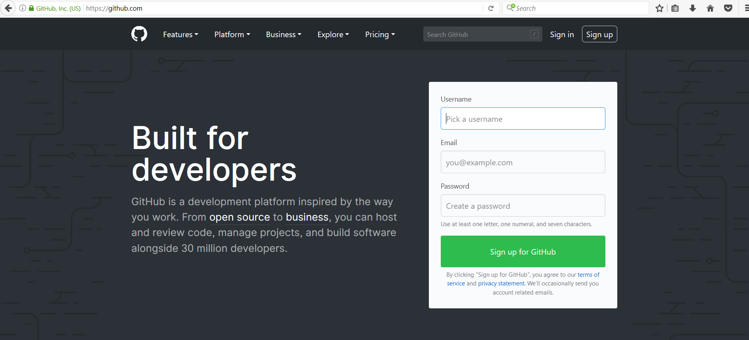
Github.com
A web-server that allows you to save/access your repository remotely.
Easy to share with collaborators.

Slide 5
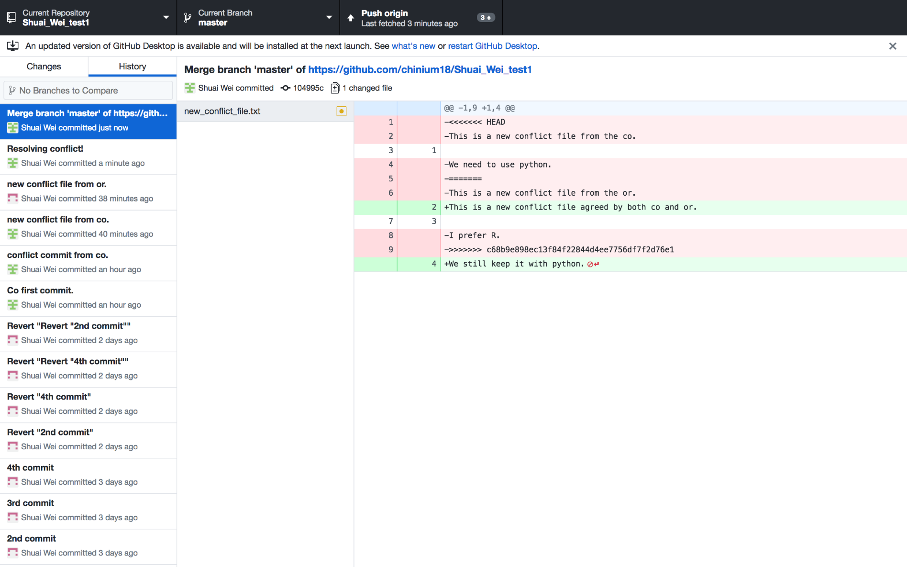
GitHub desktop
It’s a fast, easy way to contribute to projects from OS X and Windows.
GitHub workflow and replace GitHub for Mac and Windows with a unified experience across both platforms.

Slide 6
Setting up GitHub Desktop
Installing GitHub Desktop
https://desktop.github.com/
Authenticating to GitHub
Add your GitHub.com account information to GitHub Desktop
Configuring Git for GitHub Desktop
If you don’t have Git installed, you must configure it before using GitHub Desktop.

Slide 7
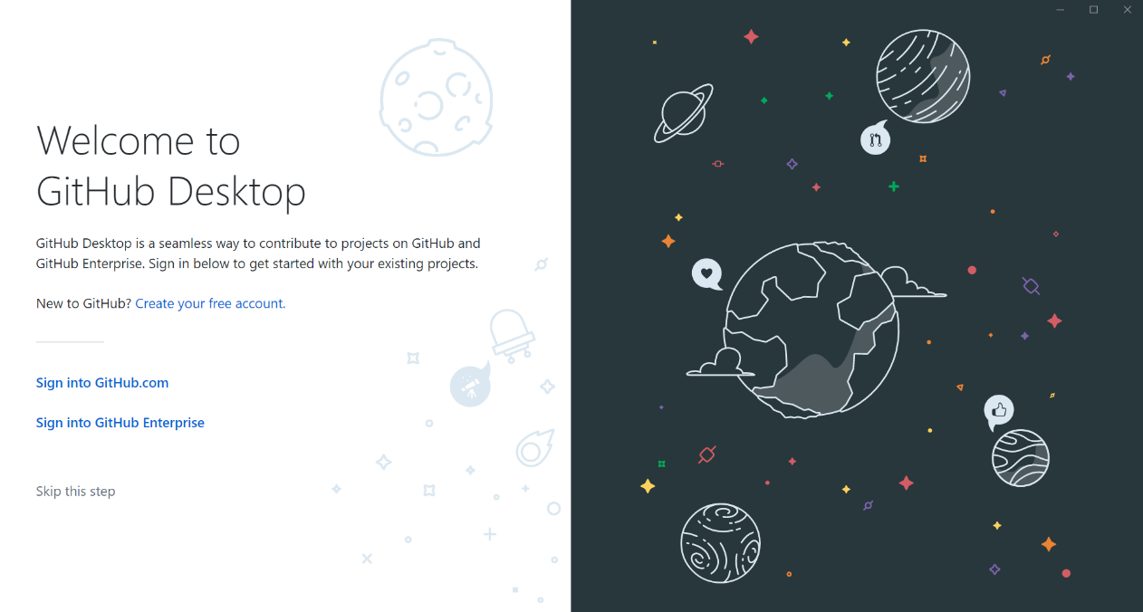
Authenticating to GitHub
or

Slide 8
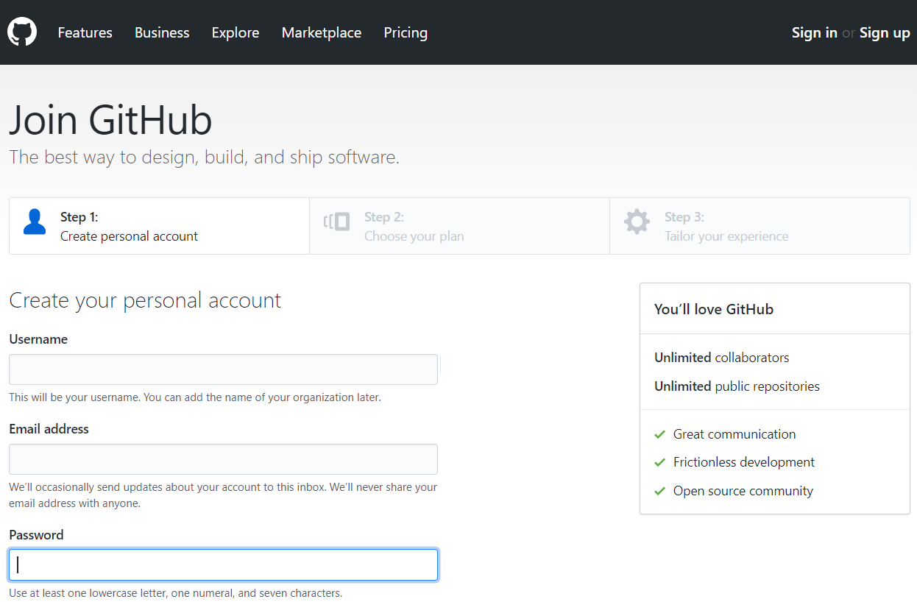
Creating GitHub account if you don’t have an account already

Slide 9
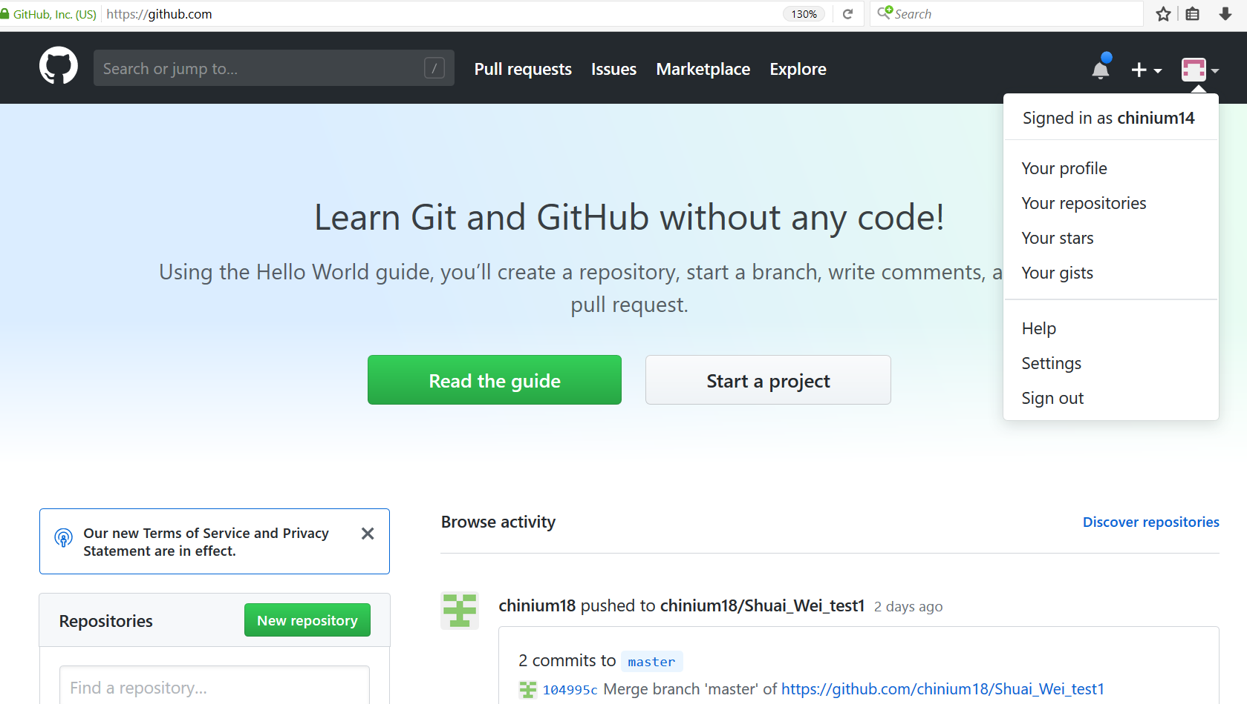
Configuring GitHub account

Slide 10
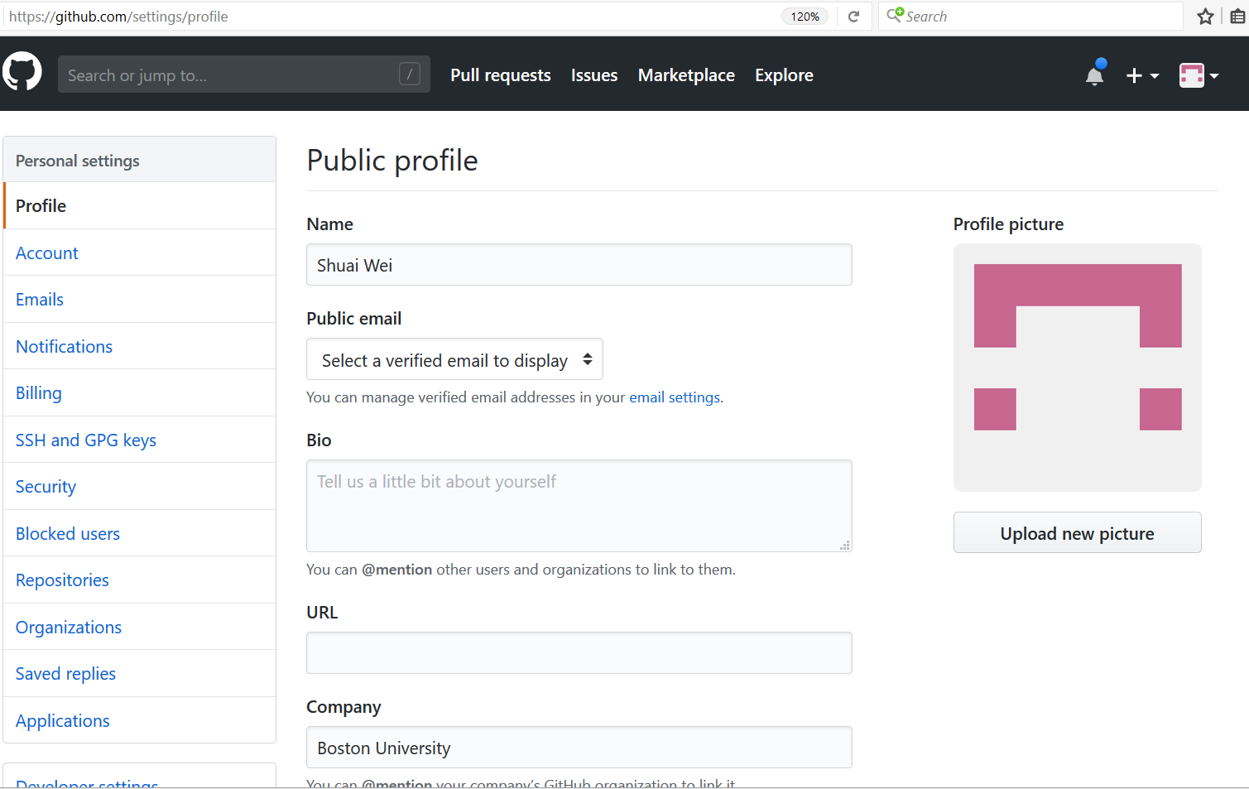
Configuring GitHub account

Slide 11
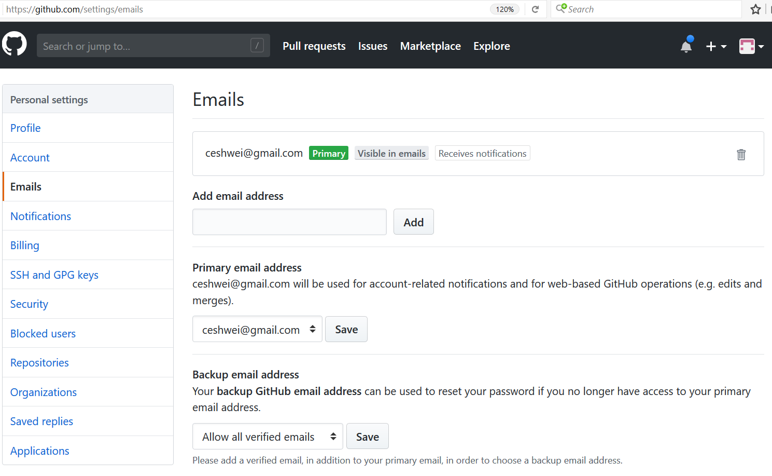
Configuring GitHub account

Slide 12
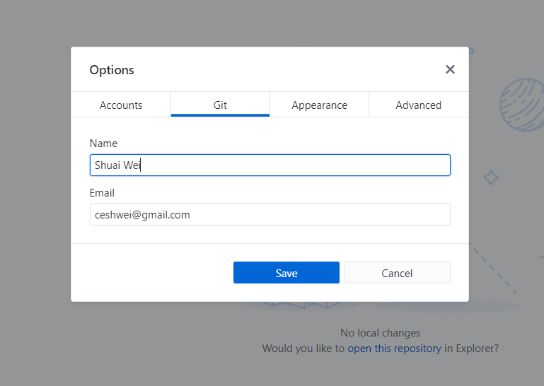
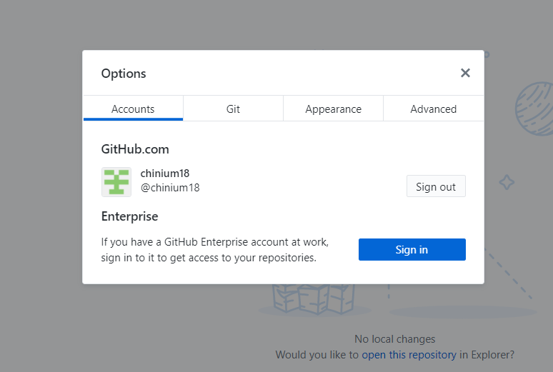
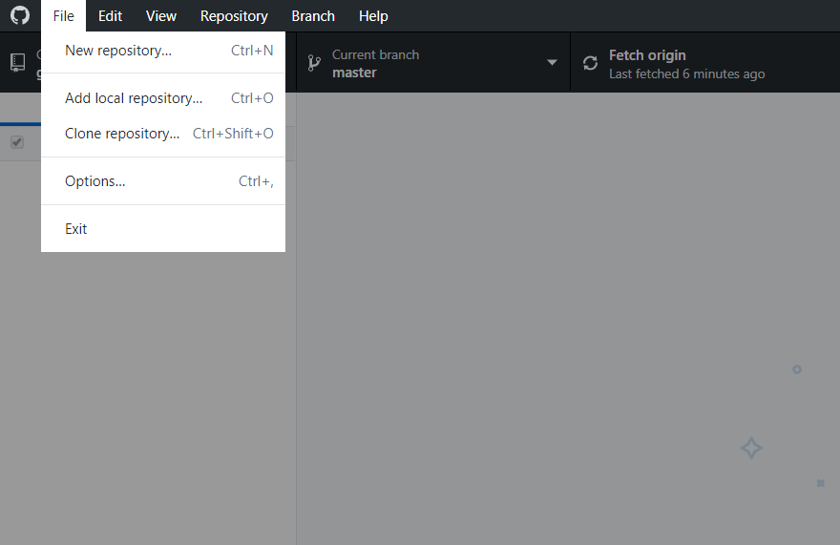
GitHub Desktop Setup

Slide 13
Using Github desktop for version control
Track and visualize each update of your code.
Revert a previous version/commit.
Branch out for large project development.

Slide 14
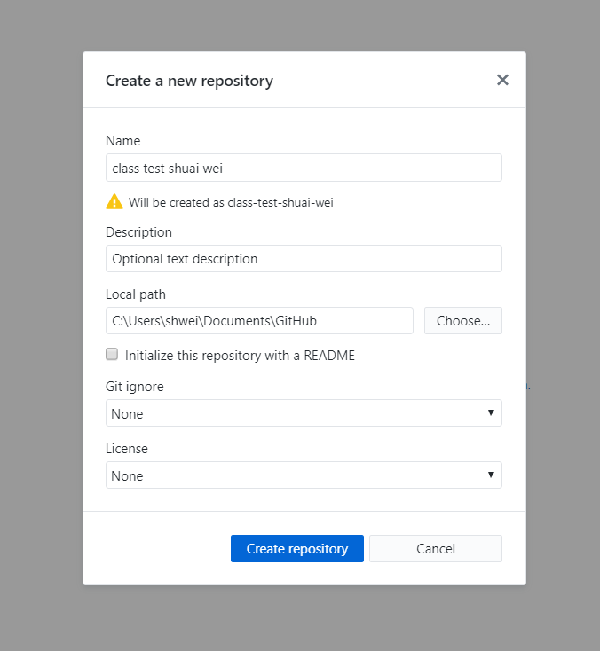
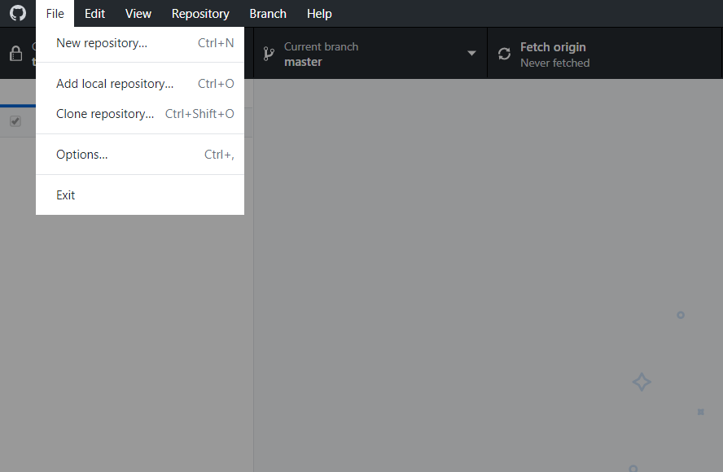
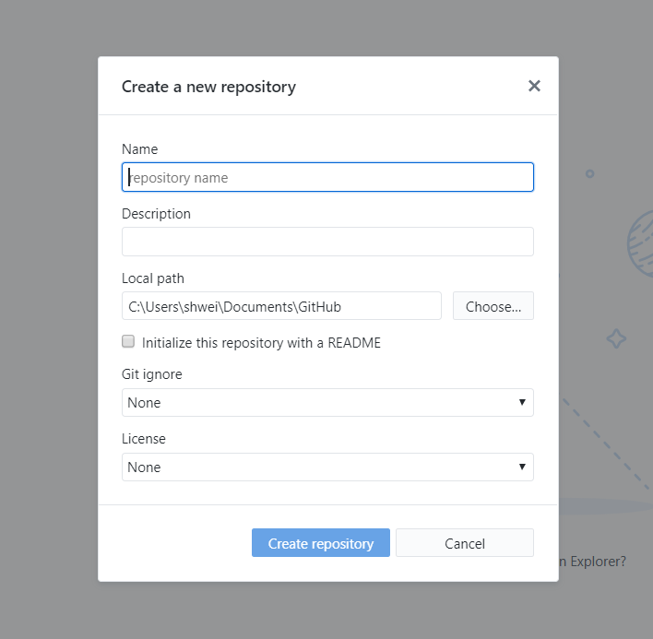
Now we can start a new project (repository) from scratch.

Slide 15
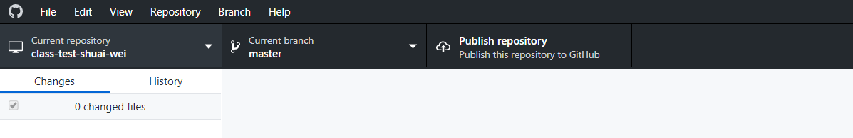
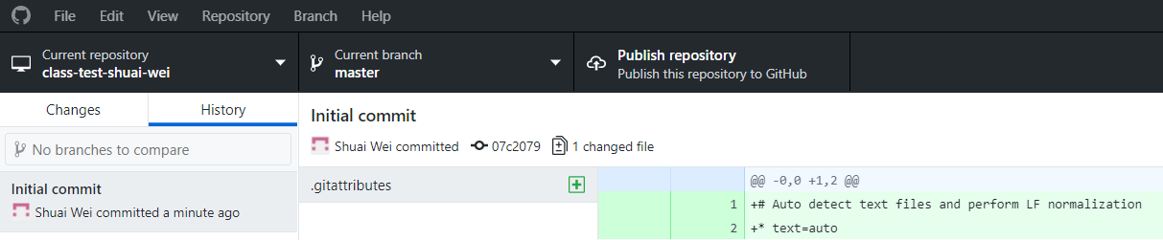
First look at the new repository by Github Desktop.

Slide 16
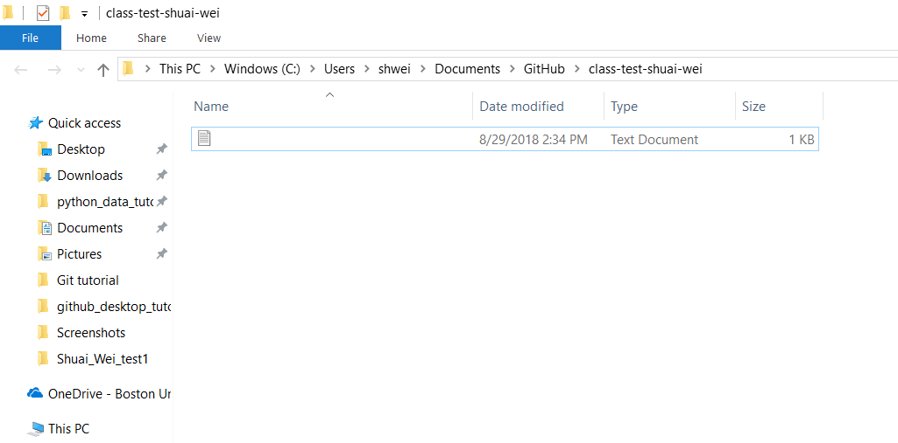
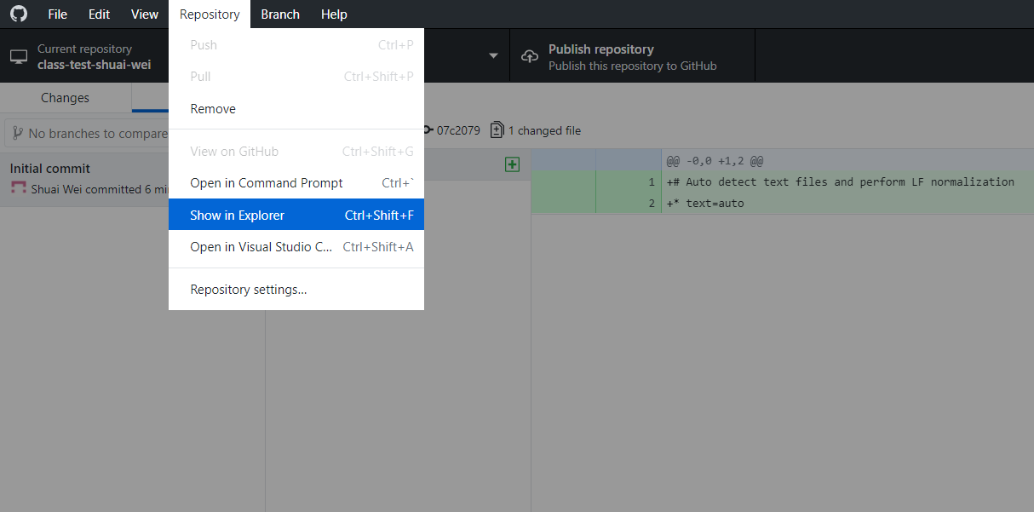
Show in folder and edit files/codes

Slide 17
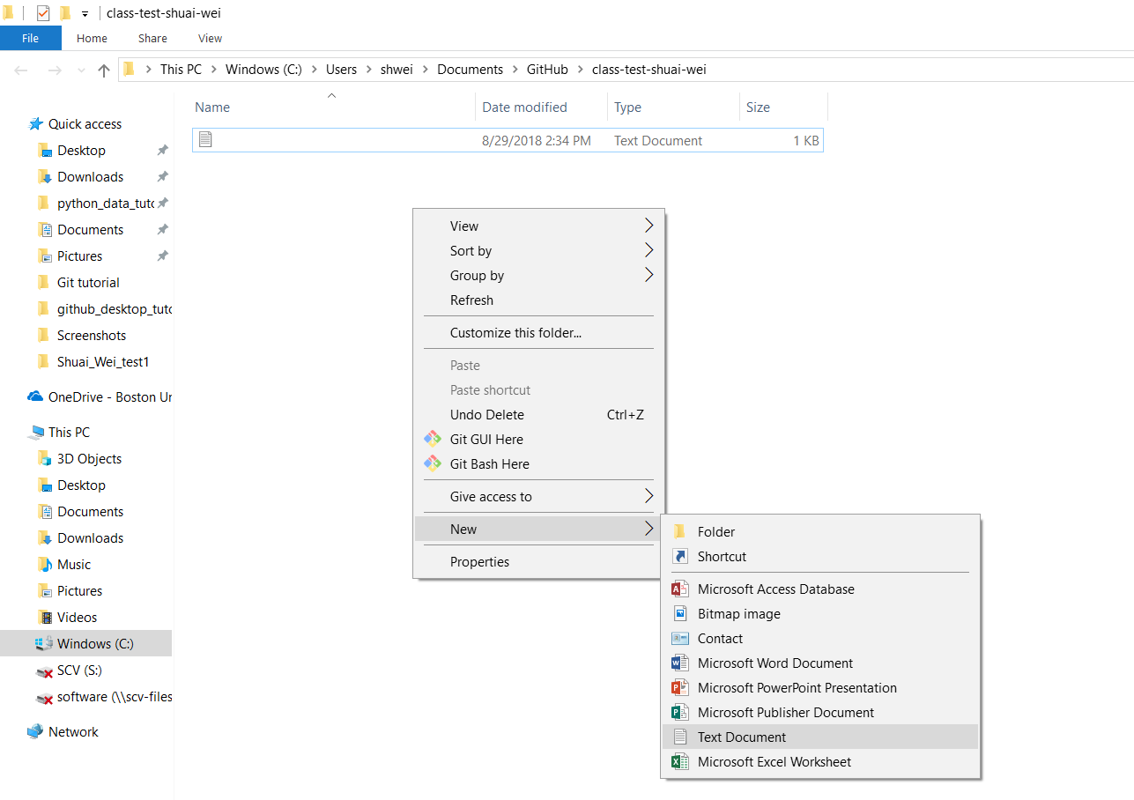
Adding a new file
Right click

Slide 18
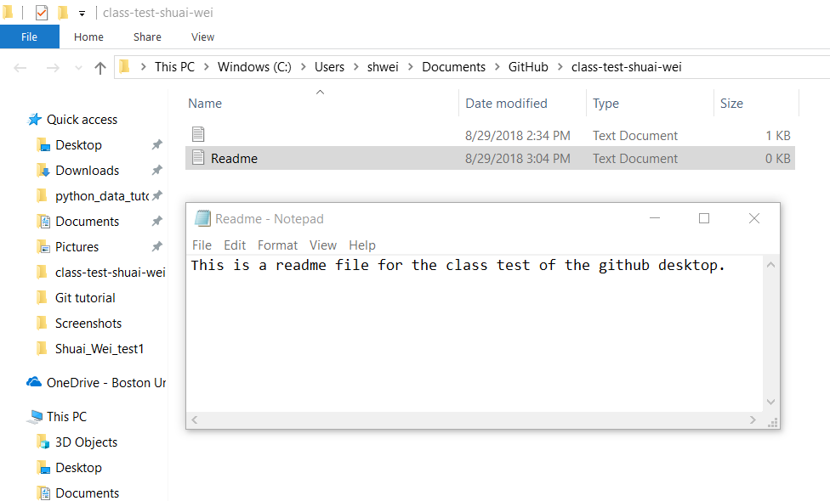
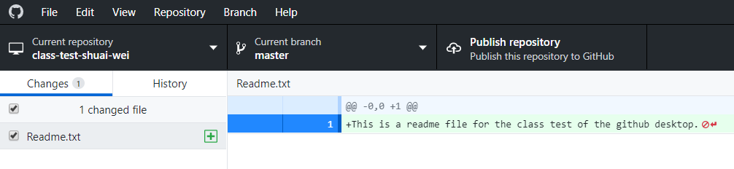
The new file can be detected by Github Desktop
Remember to save it!

Slide 19
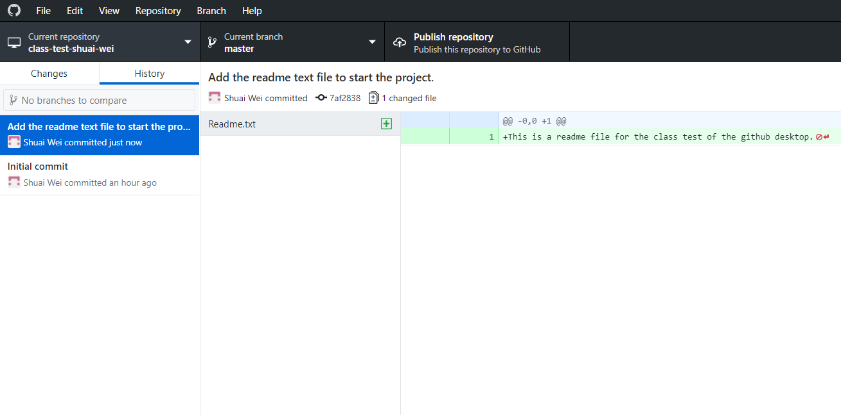
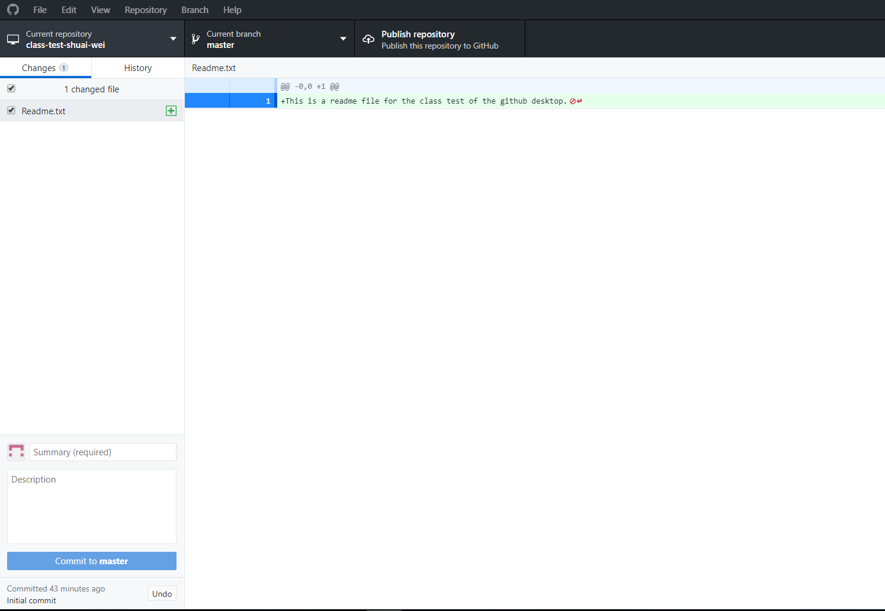
Commit this accepted change
Now click on this button to push it to Github.com repository.
This was the text input on commit title.
File name.
Input some meaningful text that briefly describe this commit.
Then click this button.

Slide 20
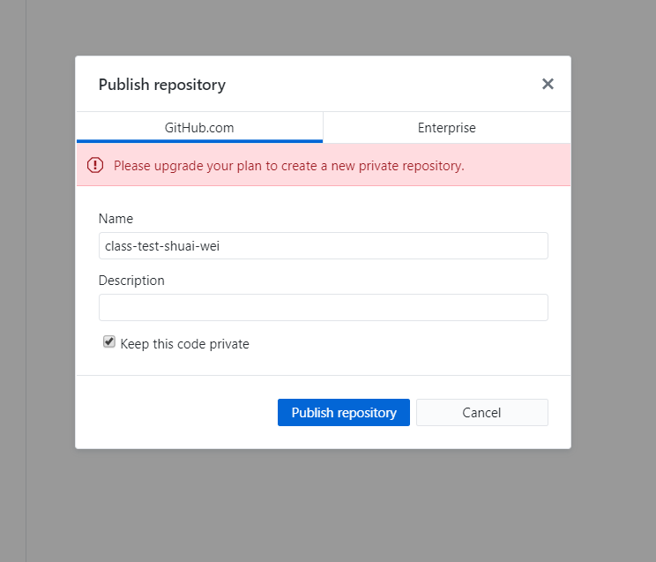
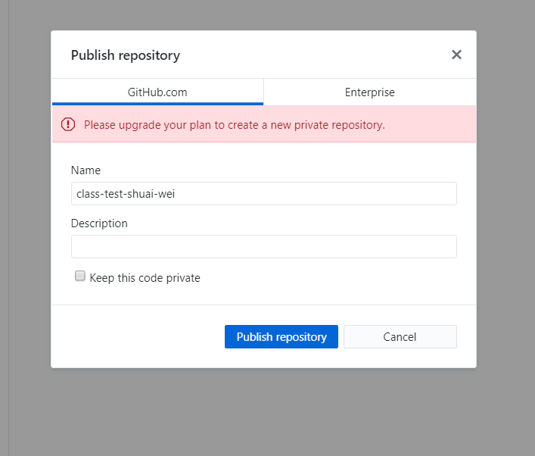
When you click on “Publish repository”
Uncheck it.

Slide 21
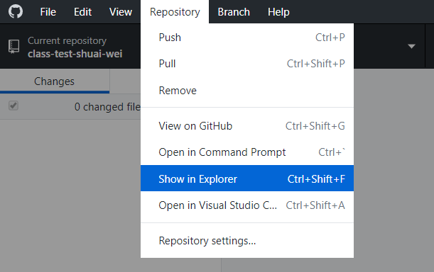
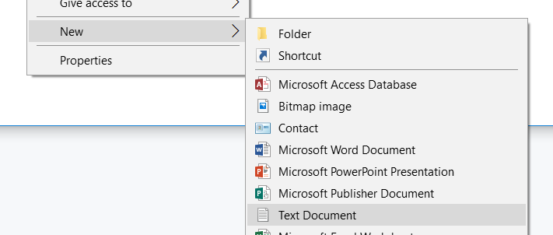
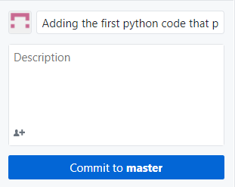
Now let’s all repeat the following steps to make the 2nd, 3rd, 4th … commits and a push.
Go to your working explorer:
Create new files:
Commit each change:
Remember to save them!

Slide 22
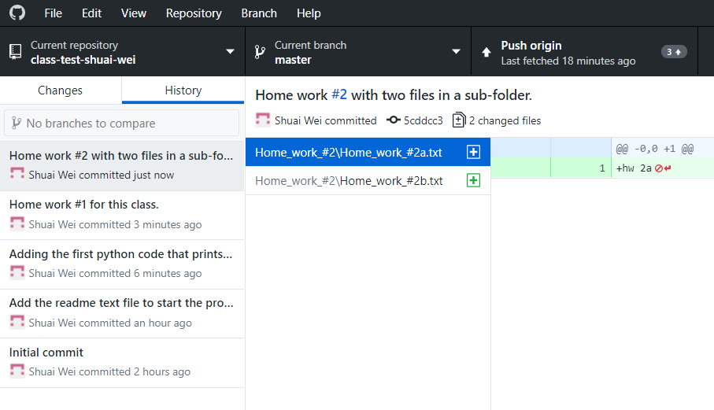
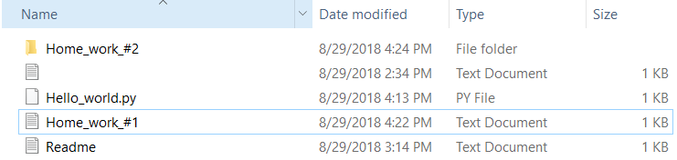
You will have a timeline of commit like this:

Slide 23
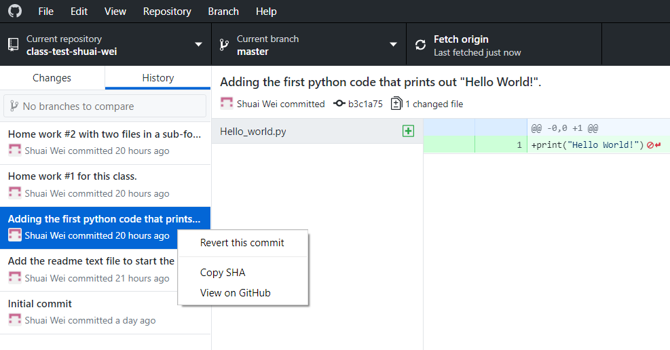
Revert a commit.
Right click on this
commit point.

Slide 24
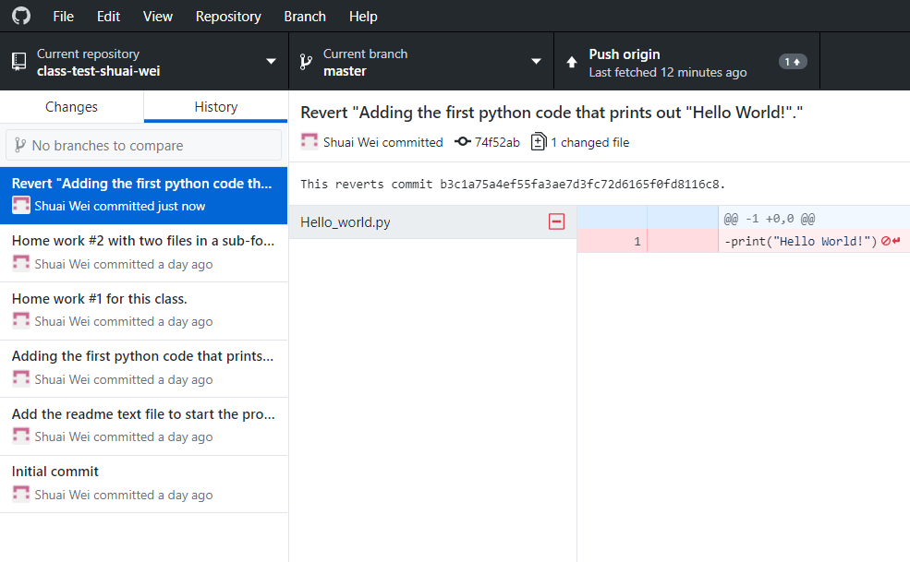
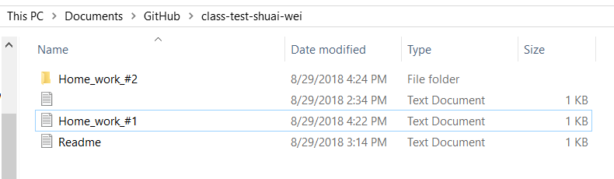
The reverted commit will be added.

Slide 25
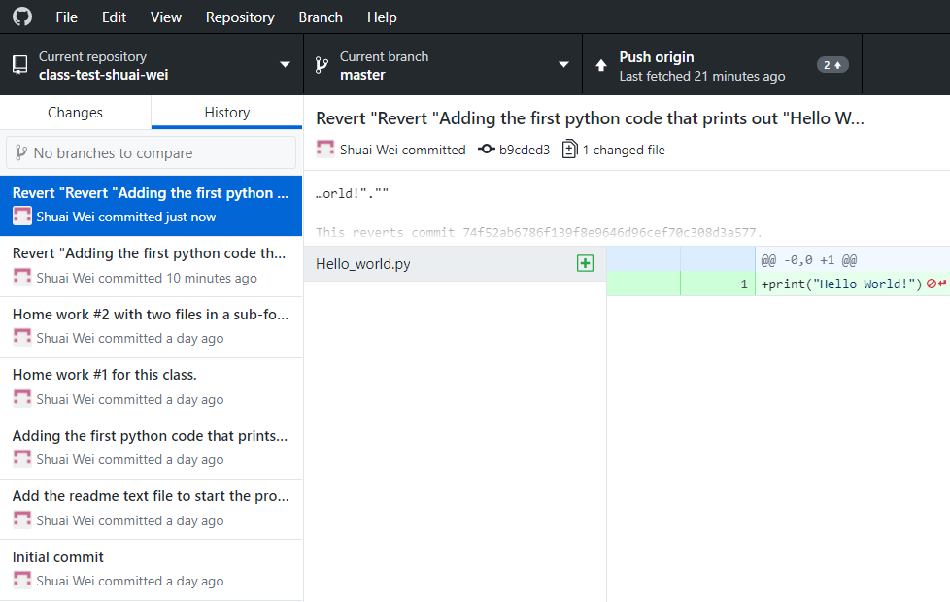
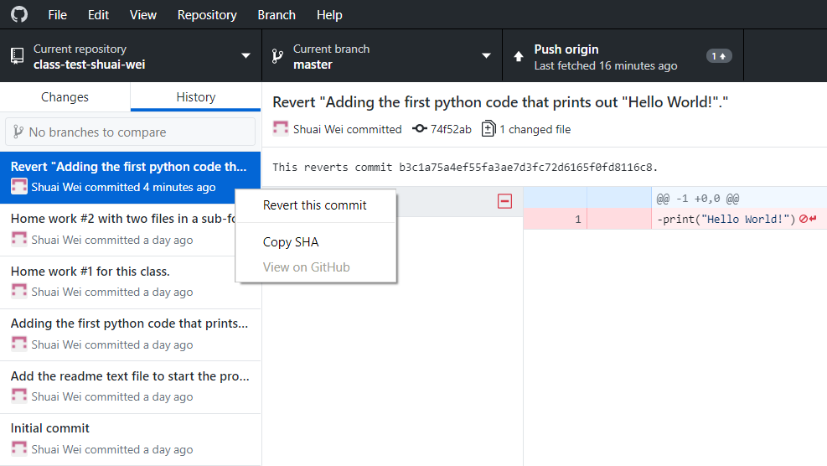
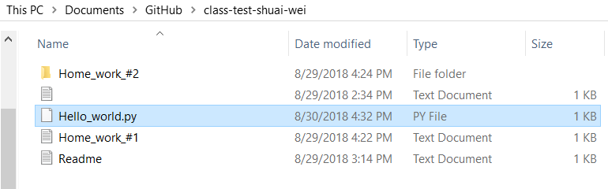
Revert the “Reverted” commit.

Slide 26
Collaborating on a project
Authorize collaborators to a private project.
Each collaborator check out/clone a copy from the github.com repository to their local computer.
Merge back to the origin repository.
Resolve conflict with collaborators.

Slide 27
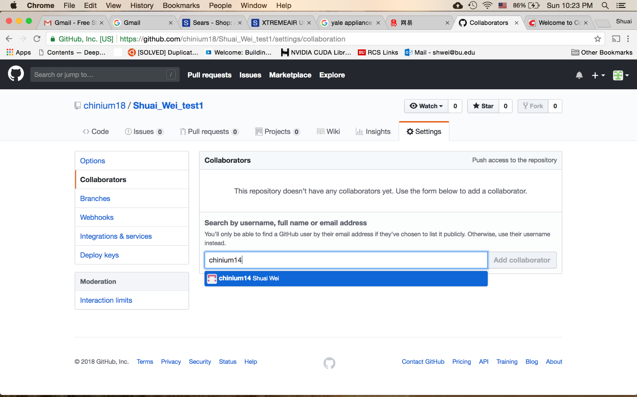
Adding collaborator to your project (repository)
Your collaborator’s github.com username

Slide 28
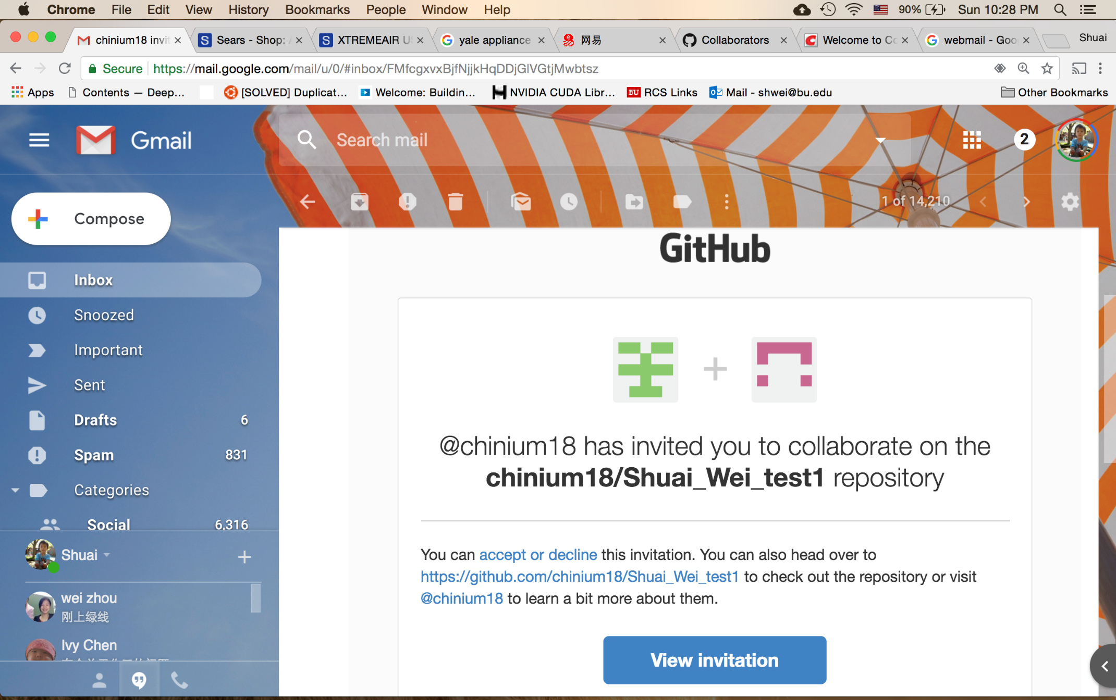
The collaborator will get an email.

Slide 29
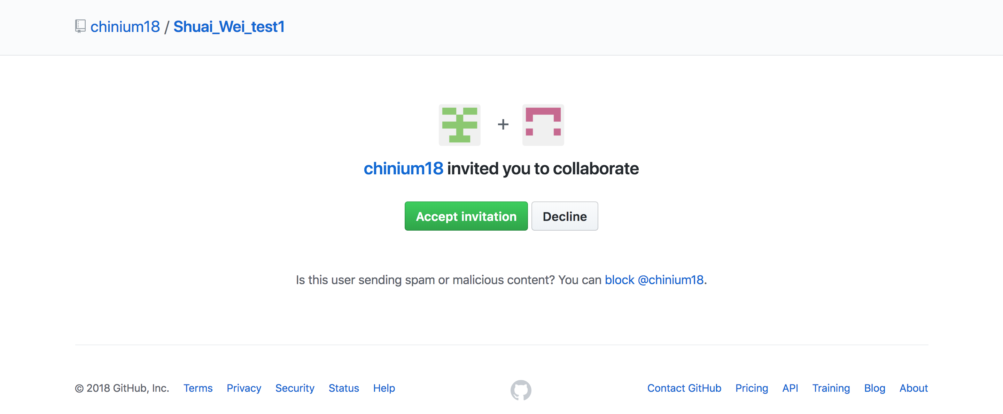
The collaborator: may check your email and find the link to this page.
Click on this button to accept the invitation.

Slide 30
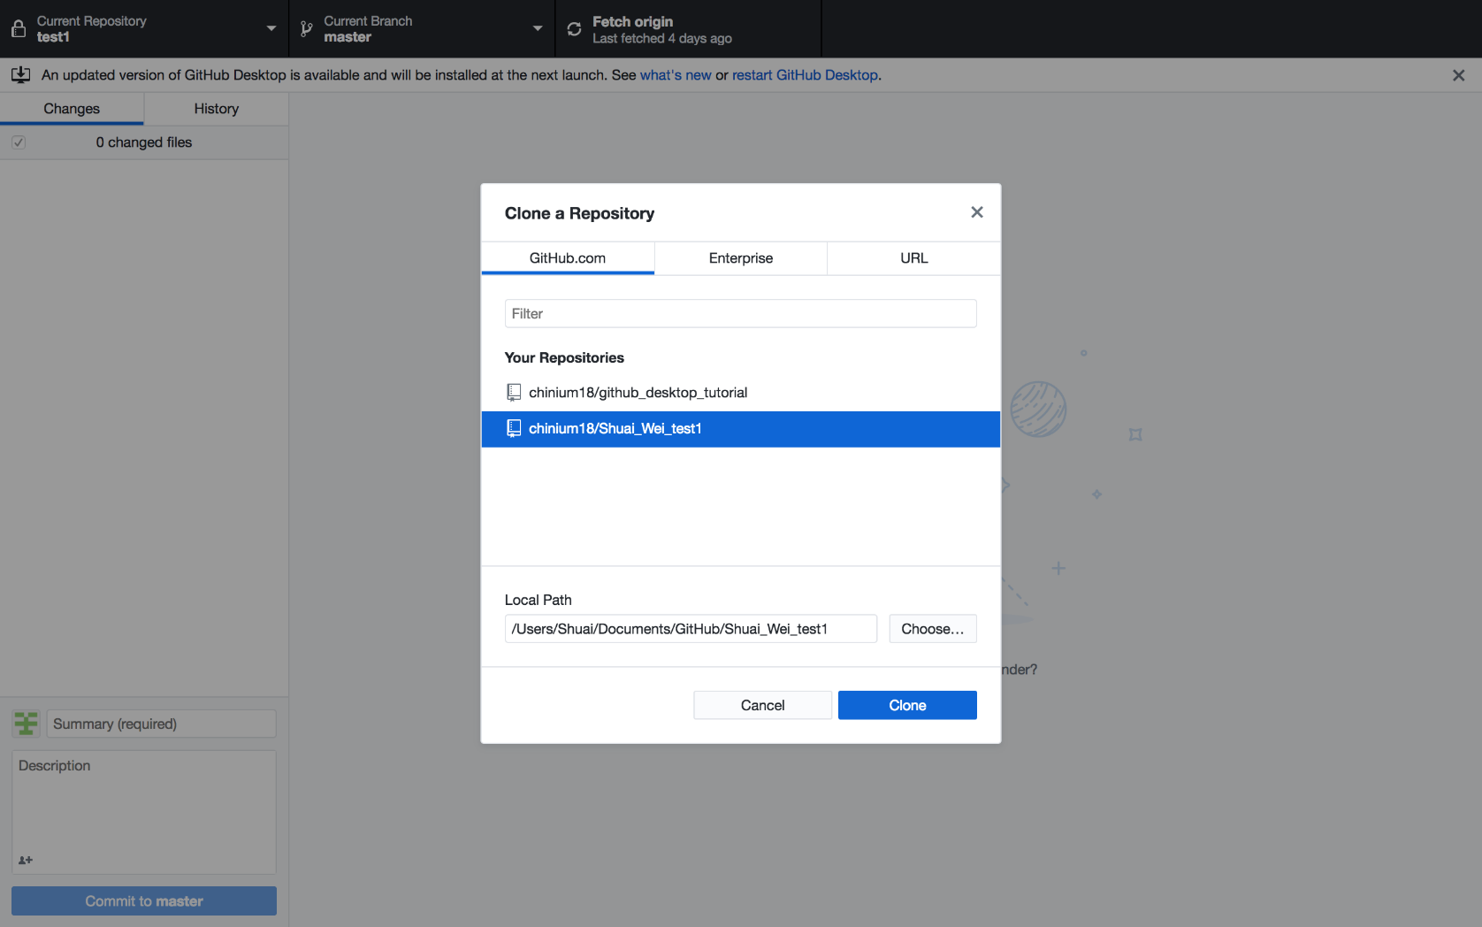
The collaborator: clone a repository from the organizer.

Slide 31
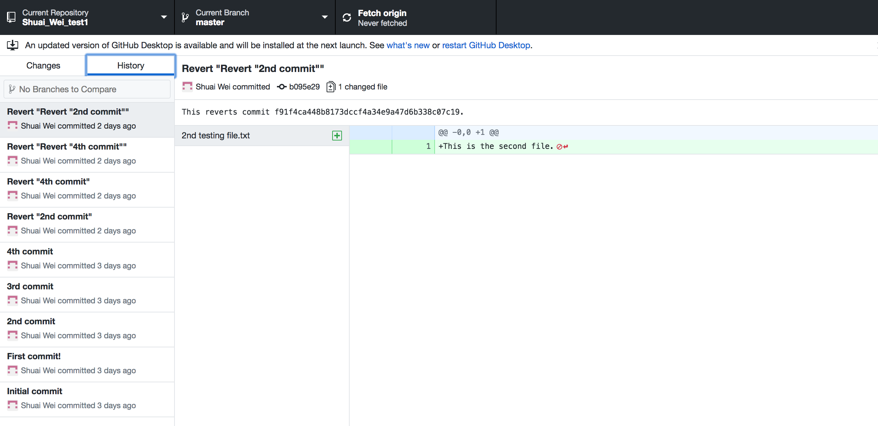
The collaborator can check out the git repository

Slide 32
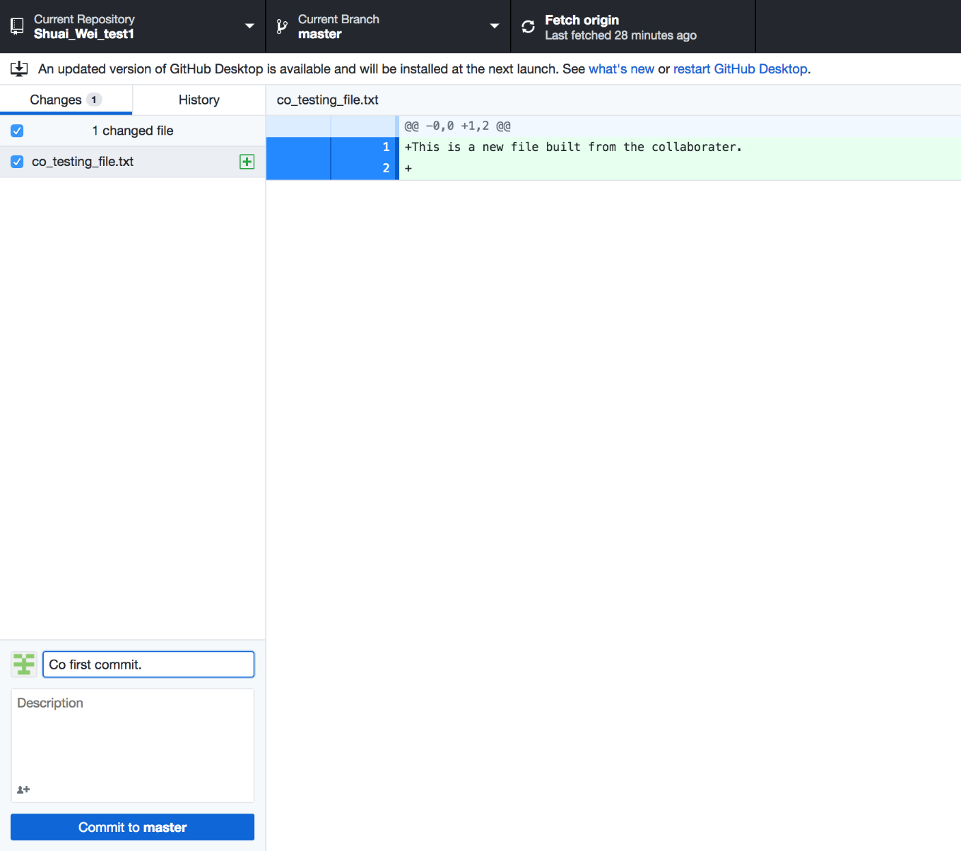
Now the collaborator can make some contribution to the repository: add a file.

Slide 33
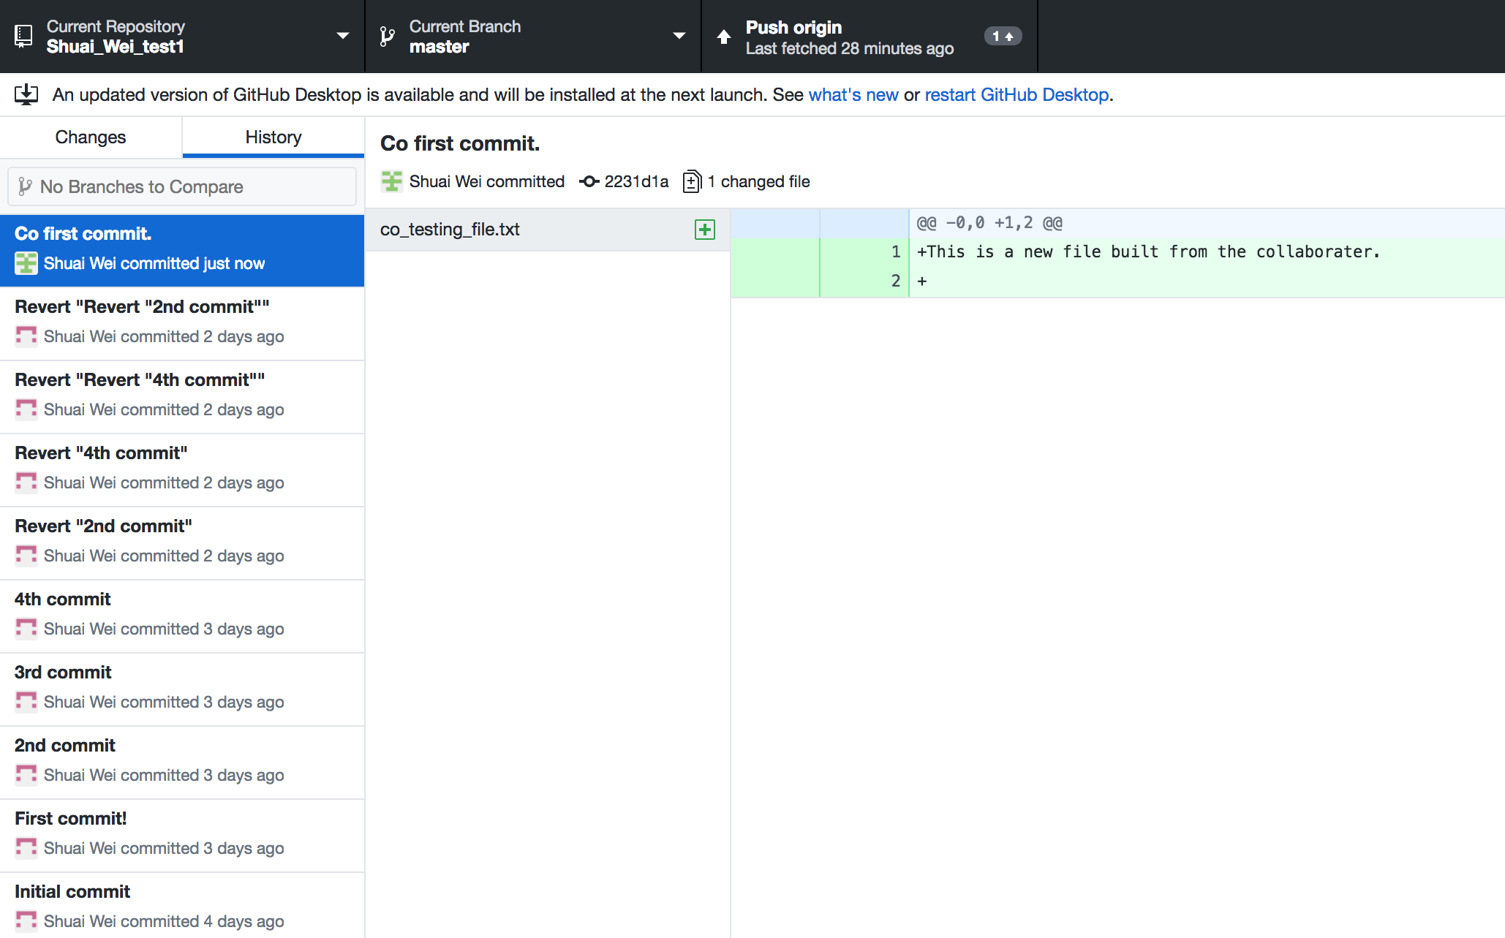
And simply push the commit to the origin repository.

Slide 34
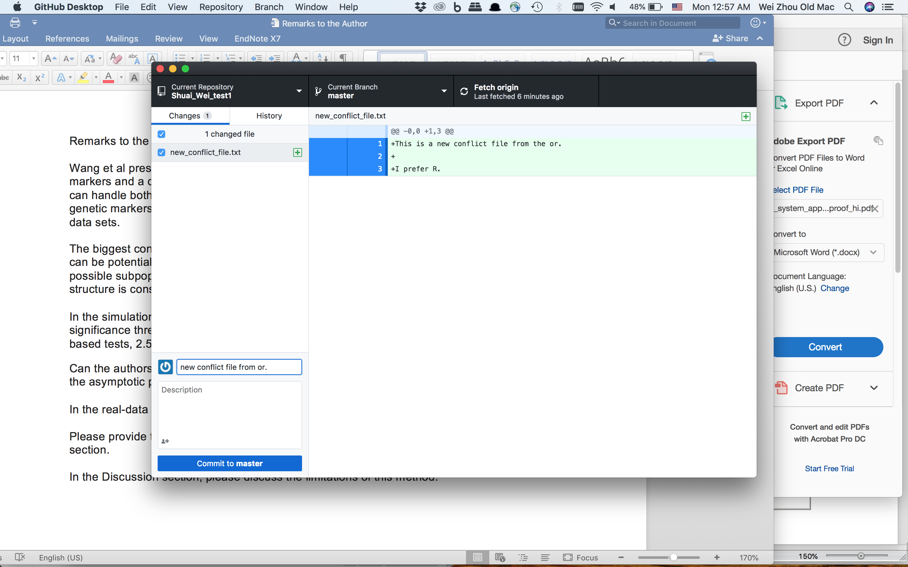
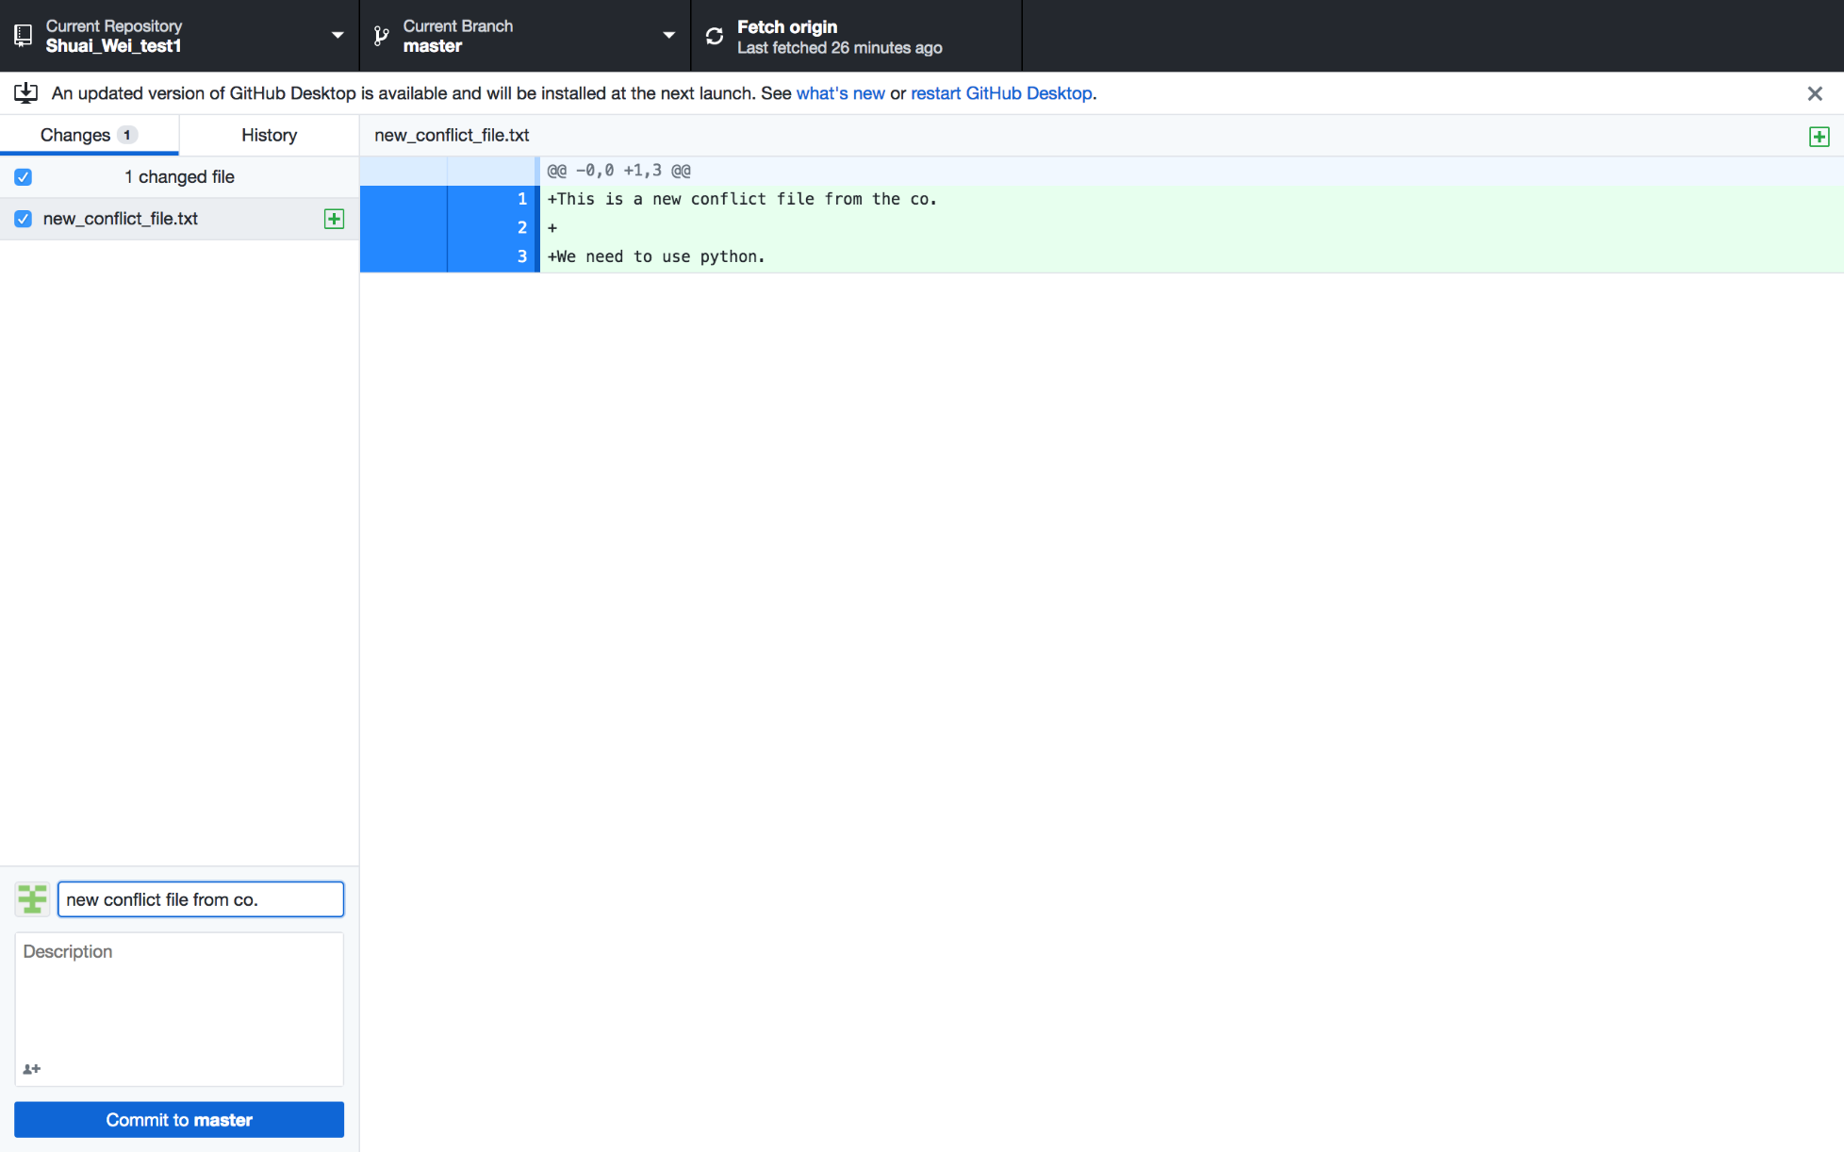
Generate a conflict between collaborators: same file name but different contents.
Conflicts here!

Slide 35
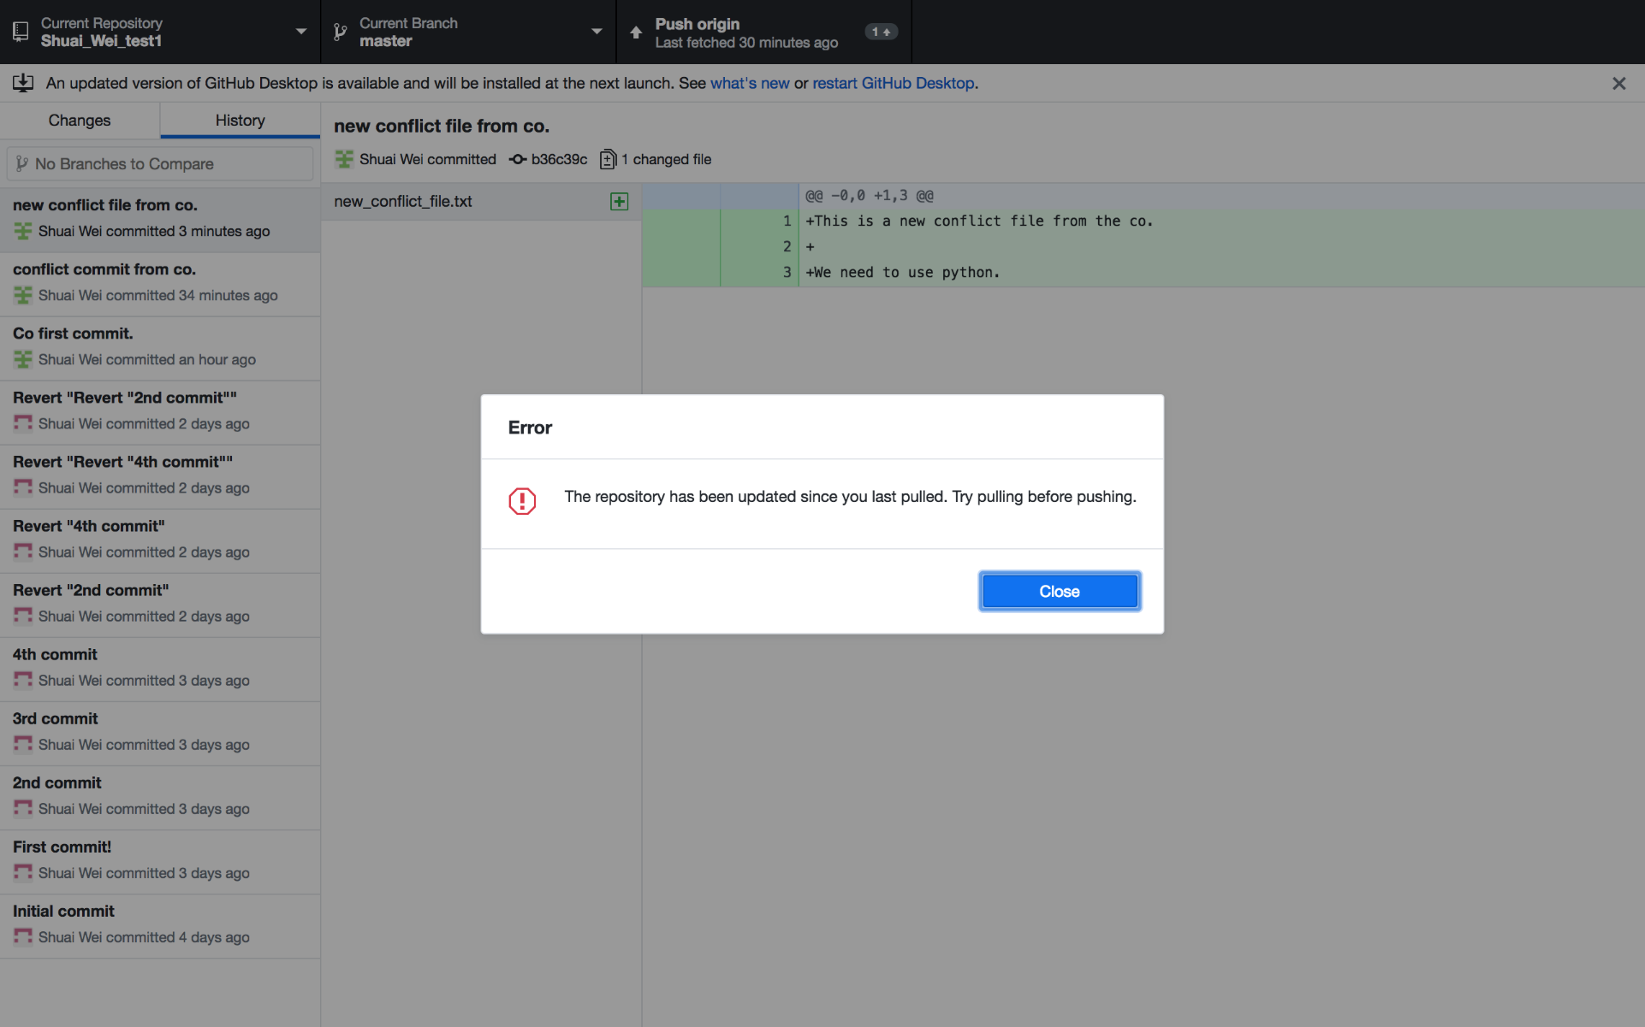
Push to the origin if you are on the latest version.

Slide 36
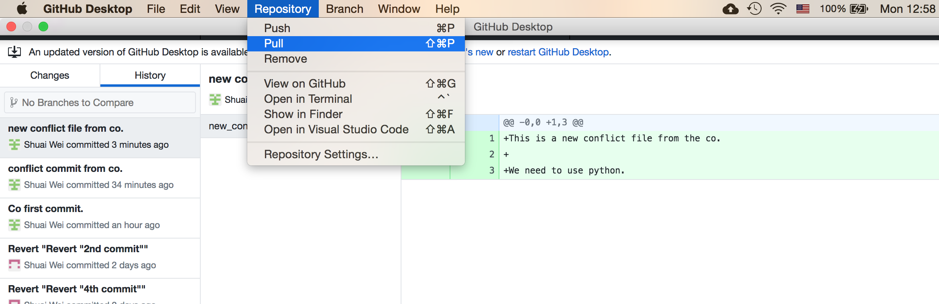
Pull the most updated version from repository

Slide 37
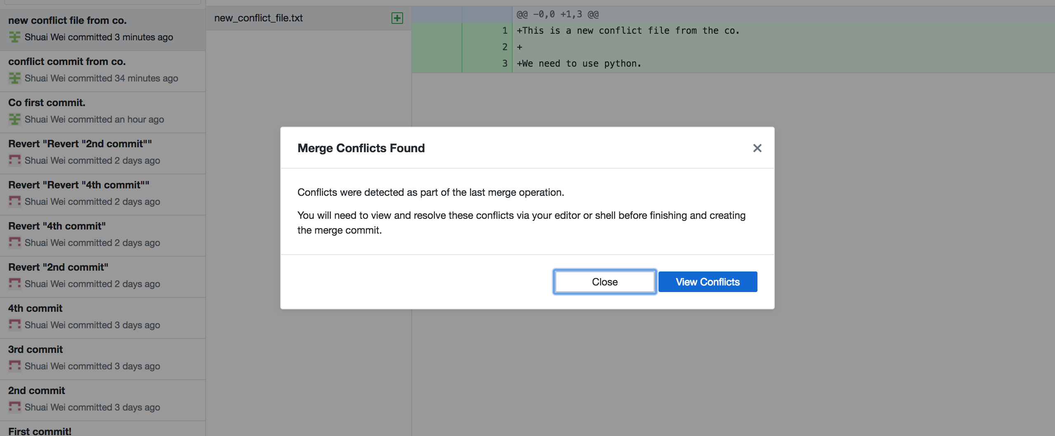
The merge conflicts found!

Slide 38
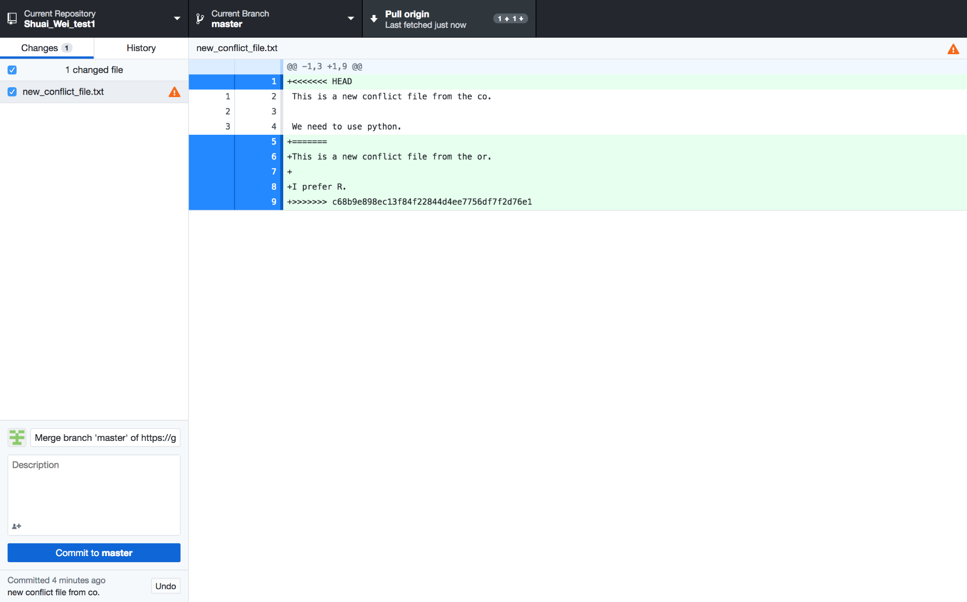
Viewing the conflict: in the file that conflicts.

Slide 39
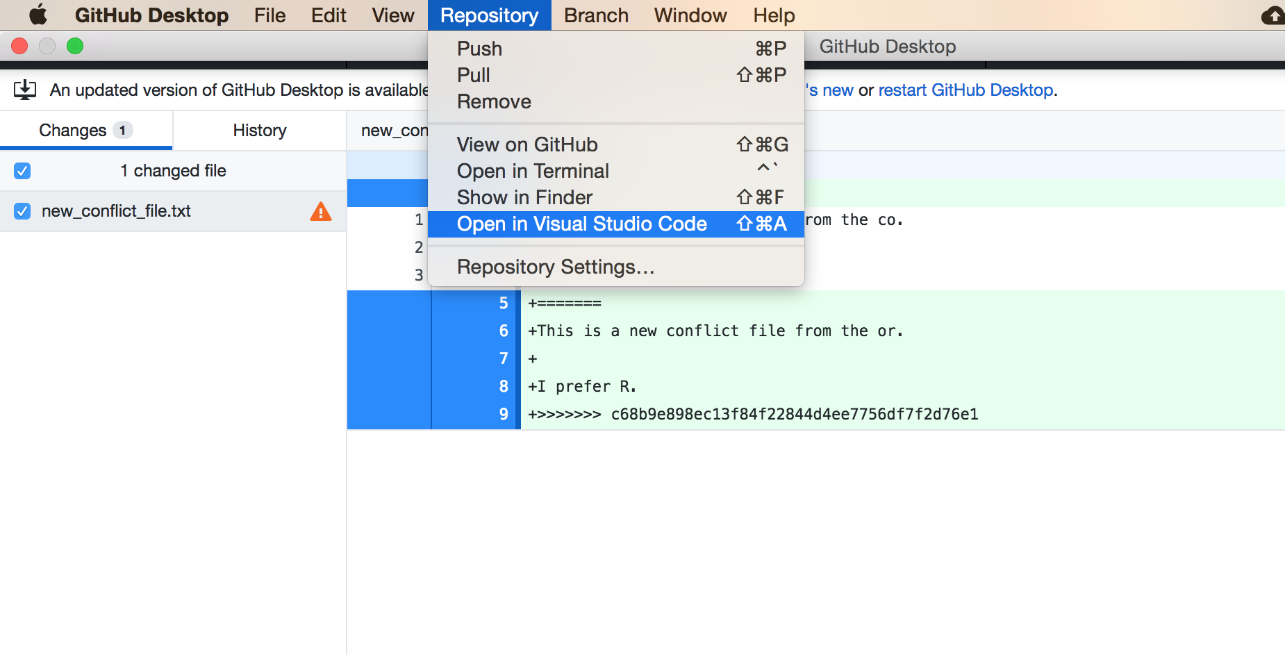
Open this file in VS Code

Slide 40
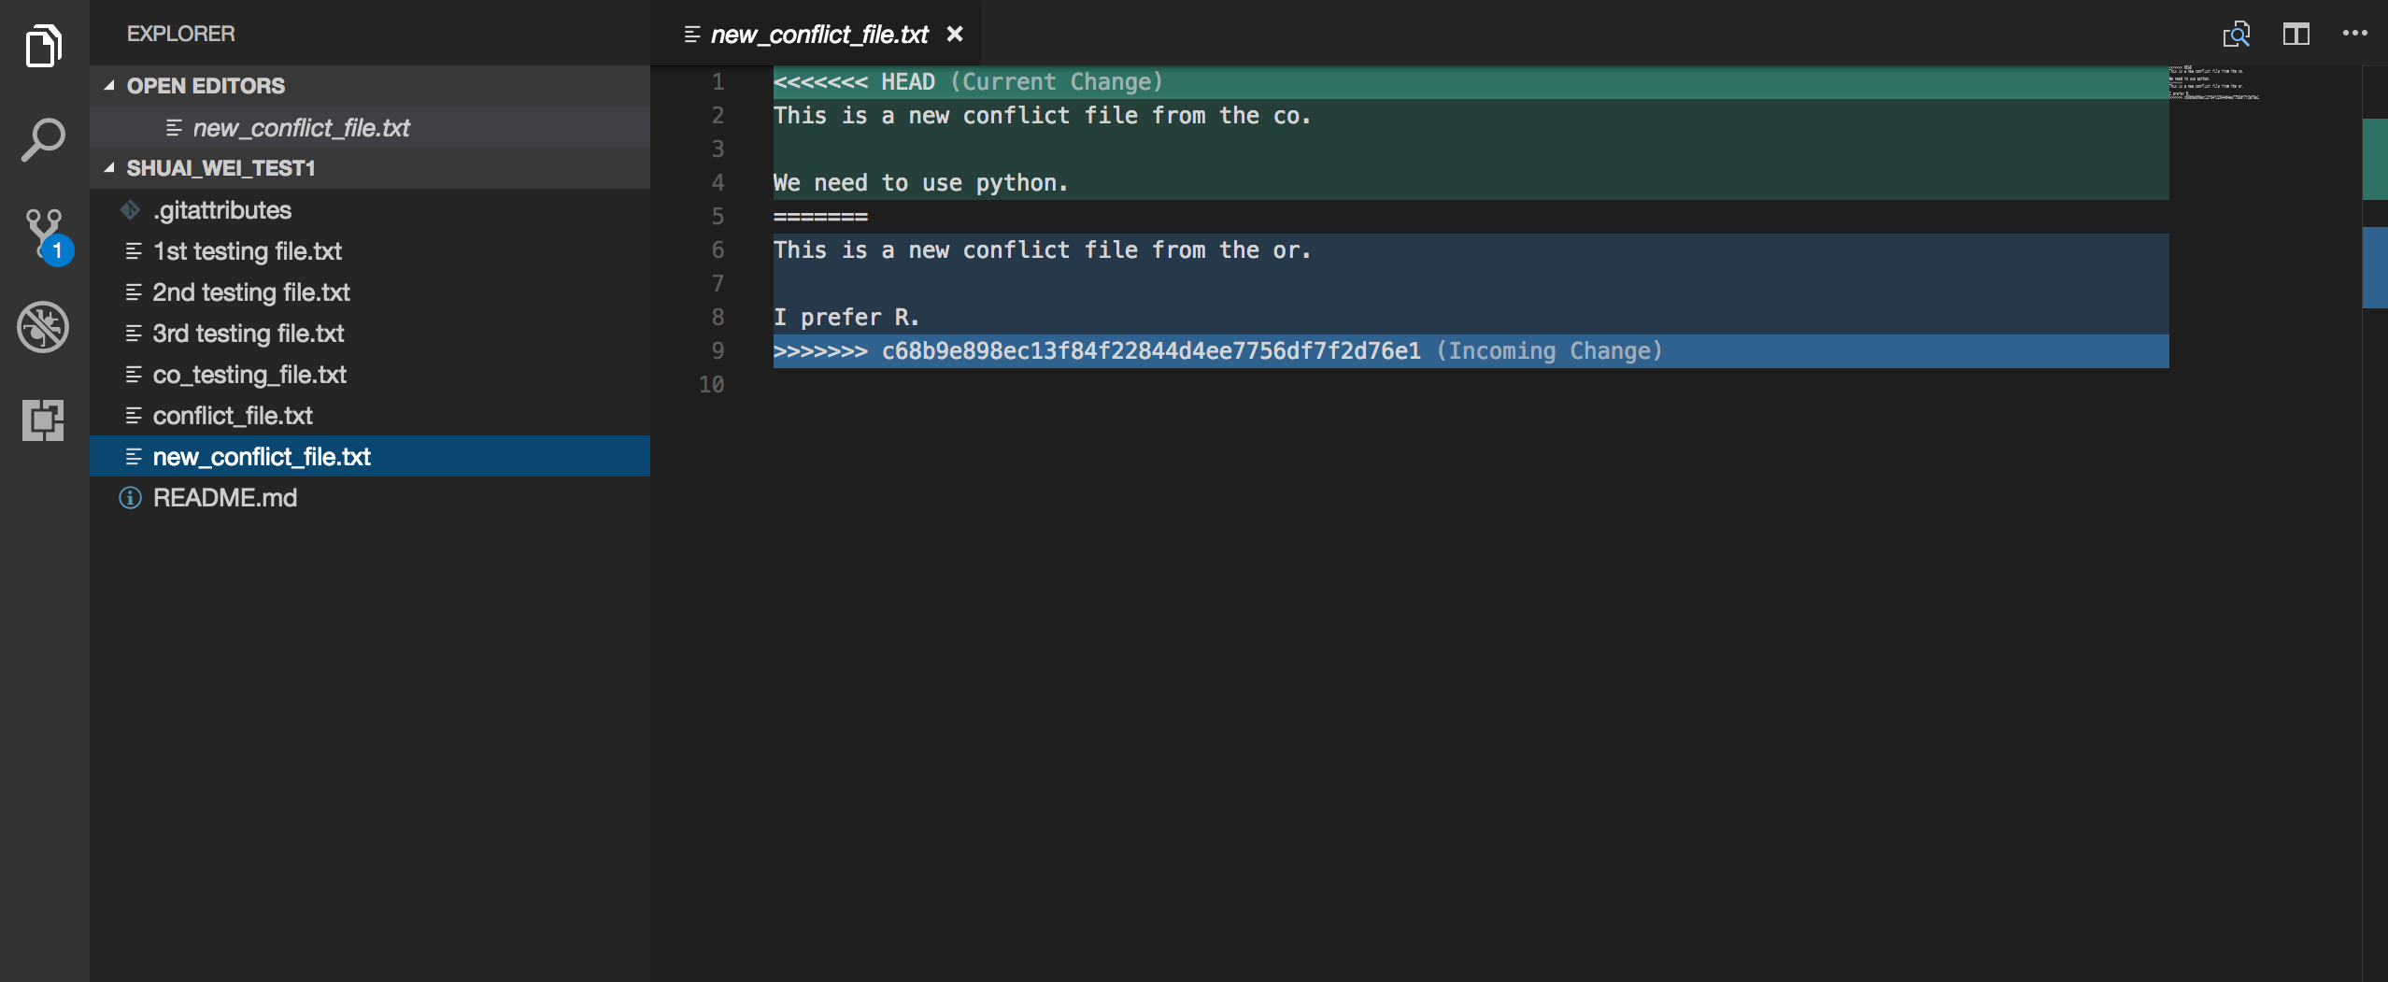
Open the file and edit it together.

Slide 41

Save the file you edited.

Slide 42

The Github Desktop view

Slide 43
Now you can commit it and push it to the origin.

Slide 44
Extras
For users who are already familiar with command lines.
Other visualization tools such as Gitk.

Slide 45

Extras: for command line users

Slide 46

Install Git to use command lines

Slide 47
Instruction for Git setup
https://help.github.com/articles/set-up-git/#setting-up-git

Slide 48

Set up Git

Slide 49

Git basic configuration
Command
Flag
Key
Value
Interpreter
program
Notes:
•Vim is the default editor used by git
•Select gedit if you are not familiar with vim or emacs editors

Slide 50

Now the command line will be available.

Slide 51

Gitk

Slide 52
Different status of files in a Git repository.

Slide 53



Branch your project

Slide 54



Make changes on the new branch

